Slide 1
Testing Phase Product Life Cycle
Dr. LAKSHMI S, Department of ECE, RIT

Slide 2
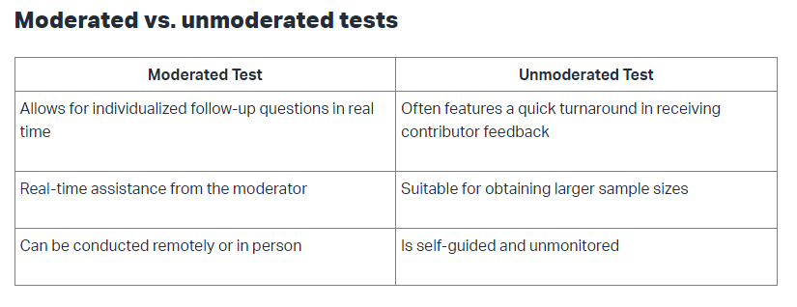

Slide 3
Product Life Cycle
Product development represents the process where the product is conceived, developed, produced and tested
Product management includes the launch effort and all other activities that take place after the launch
Thus, product development occurs during the pre-market phase of extended product life cycle
Product management essentially occurs in the post launch or marketing phase of the product life cycle.

Slide 4
Designers and marketing professionals find great utility in a study of product life cycle (PLC)
Every product goes through a cycle from birth, into an initial growth stage, to a relatively stable period, and finally to a declining stage that eventfully ends in the death of the product
In the Introductory stage the product is new and consumer acceptance is low, so sales are low

Slide 5
In this early stage of the product life cycle the rate of product change is rapid as management tries to maximize performance or product uniqueness in an attempt to enhance customer acceptance
When the product has entered the growth stage, knowledge of the product and its capabilities are known to a large number of customers
There may be emphasis on custom designing the product for slightly different customer needs

Slide 6
At the maturity stage, the product is widely accepted, sales are stable and are growing at the same rate as the economy as a whole
When the product reaches this stage, attempts should be made to rejuvenate it by incremental innovation or the development of still new applications

Slide 7
Products in the maturity stage usually experience considerable competition
Thus, there is great emphasis on reducing the cost of a mature product
At some point, the product enters the decline stage and sales decrease because a new and better product has entered the market to fulfill the same societal need

Slide 8
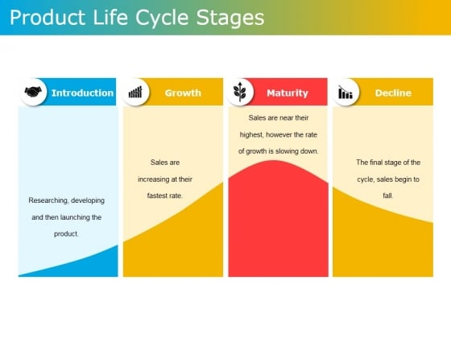

Slide 9
Four Stages of Product Life Cycle
Introduction
First Stage: Starting with product ideation and continuing until the product is introduced in the market.
Brands conduct marketing and promotional activities, adapt product life strategies, etc., to ensure the product reaches its target audience.
Growth
In this stage, consumers start buying the product, it becomes popular, and its sales increase
In simpler words, the customer begins recognizing the brand
Brands undertake different brand retention strategies to build a loyal customer base.

Slide 10
Maturity
Sales slow down, indicating that the market has begun to reach saturation
Competition is higher than at another location, and profits start getting thinner by the day.
Brands look for ways to innovate their product and strategies to increase their longevity.
Decline
While companies make all efforts throughout the different stages of the product life cycle to ensure that it stays alive in the market, an eventual decline cannot be ruled out
A decline’s characteristics are a drop in sales, affected revenue, changed consumer behavior and fluctuating demand.

Slide 11
Every product undergoes a product life cycle
Although every product’s journey differs, the PLC remains the same- introduction, growth, maturity, and decline
Knowledge of PLC will help you tactfully utilize the company’s resources, predict the future, and make strategic plans for product launches, among others

Slide 12
Examples:
Typewriter
Typewriters were replaced by computers and laptops for their speed, effectiveness, and holistic experience.
VCR
VCRs were effectively phased out after the advent of CDs, DVDs, and the Internet.

Slide 13
Examples:
Electric vehicles
Electric vehicles are currently in the growth stage because their demand is slowly picking up
AI Products
Like electric vehicles, artificial intelligence (AI) has been in development and use for years, but due to the continued developments in AI, there are many products that are still in the market introduction stage of the product life cycle
These include innovations that are still being developed, such as autonomous vehicles, which are yet to be adopted by consumers

Slide 14
Any other examples ??

